Slide 1
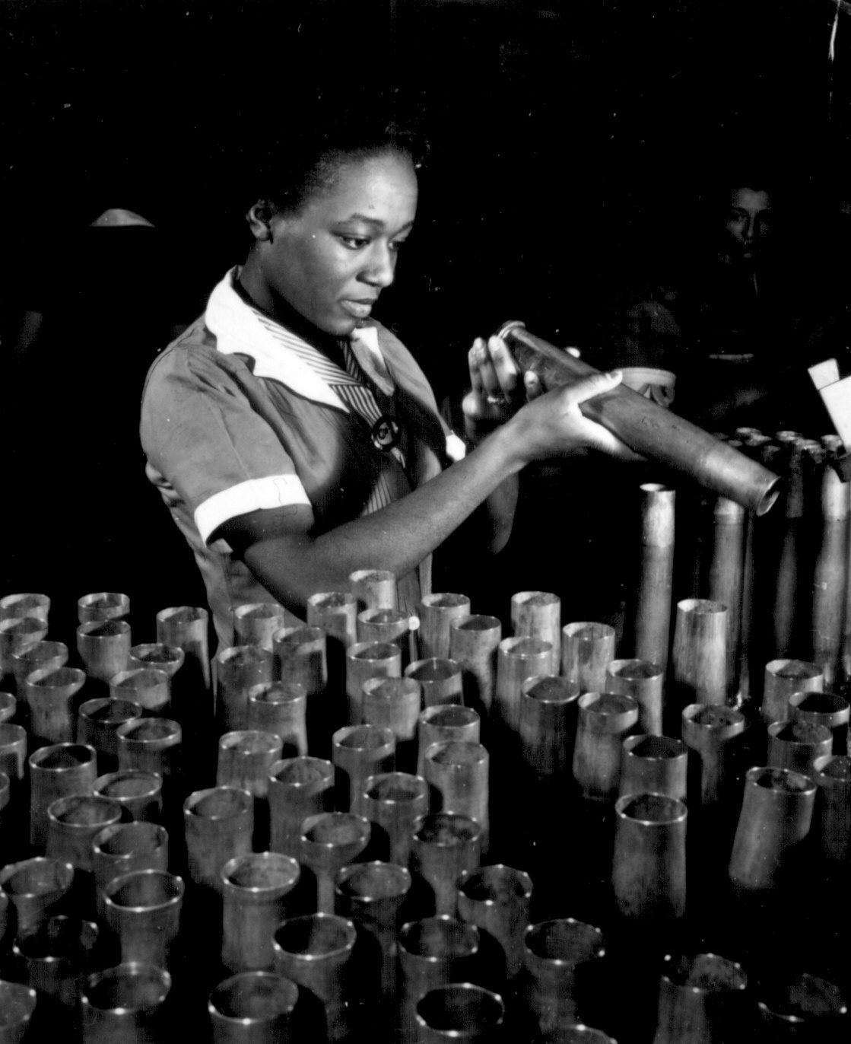
Notes:
Bertha Stallworth, age 21, inspects the end of a 40 mm artillery cartridge case at Frankford Arsenal, Philadelphia. National Archives

Slide 2
Double Victory
In what ways did African-American women help achieve a “Double Victory” in World War II?

Slide 3
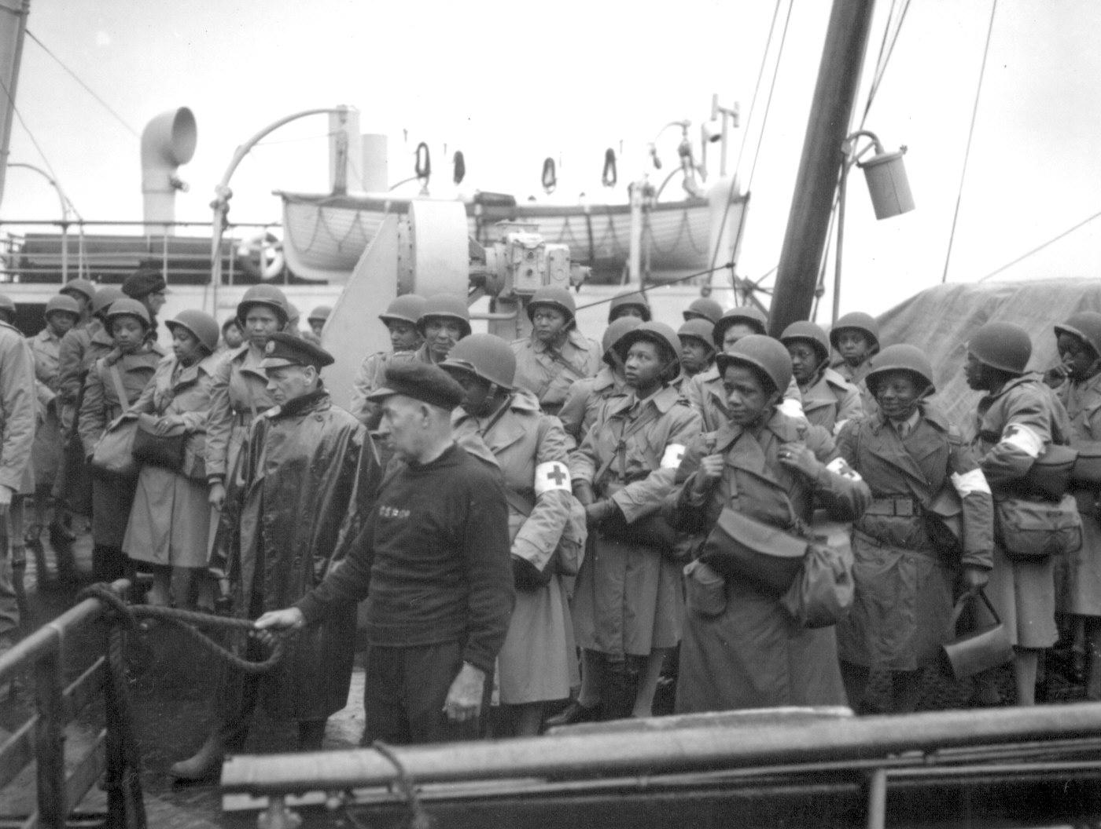
Notes:
"U.S. Army nurses, newly arrived, line the rail of their vessel as it pulls into port of Greenock, Scotland, in European Theater of Operations. They wait to disembark as the gangplank is lowered to the dock." August 15, 1944. Meyer. 111-SC-192605-S.

Slide 4
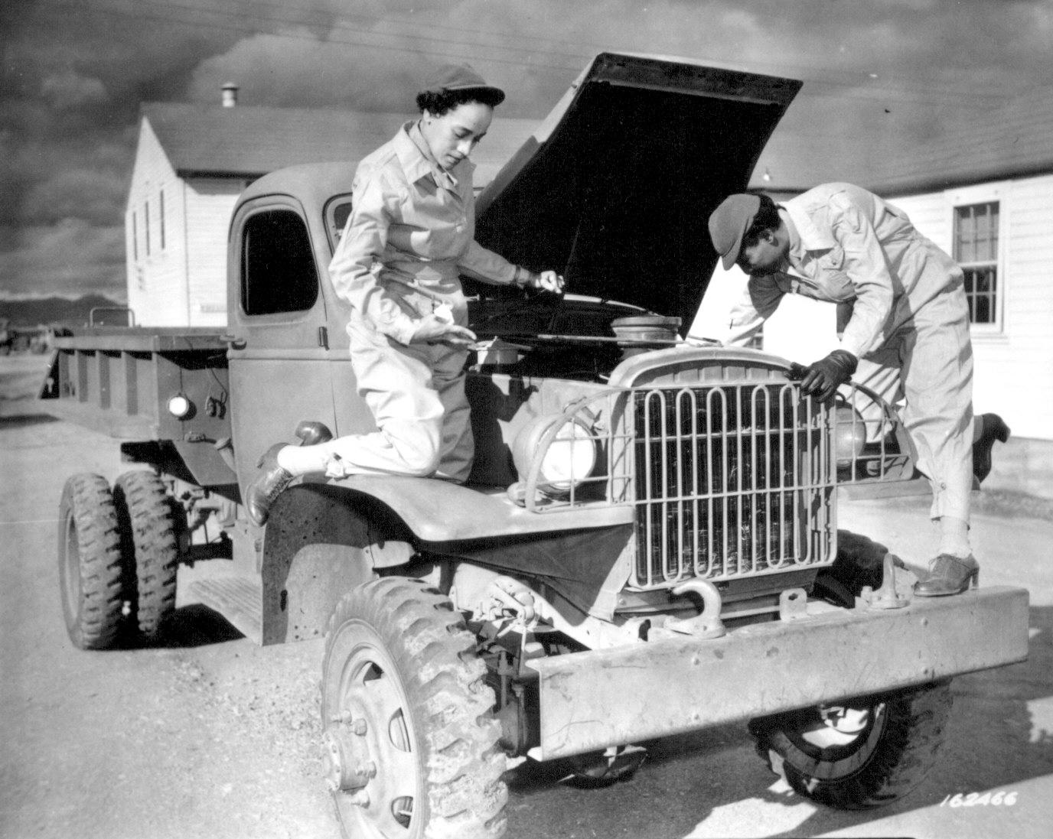
Notes:
"Auxiliaries Ruth Wade and Lucille Mayo (left to right) further demonstrate their ability to service trucks as taught them during the processing period at Fort Des Moines and put into practice at Fort Huachuca, Arizona." December 8, 1942. Oster. 111-SC-162466.

Slide 5
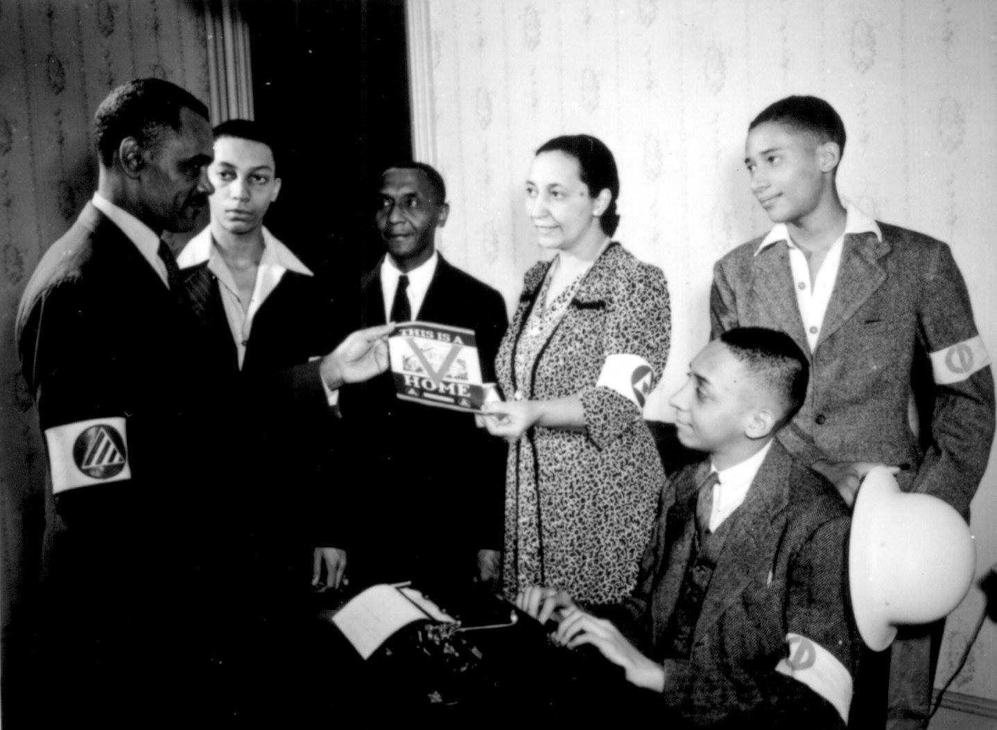
Notes:
"V" home campaign, Washington, DC. October 1942. 171-OCD-140.

Slide 6
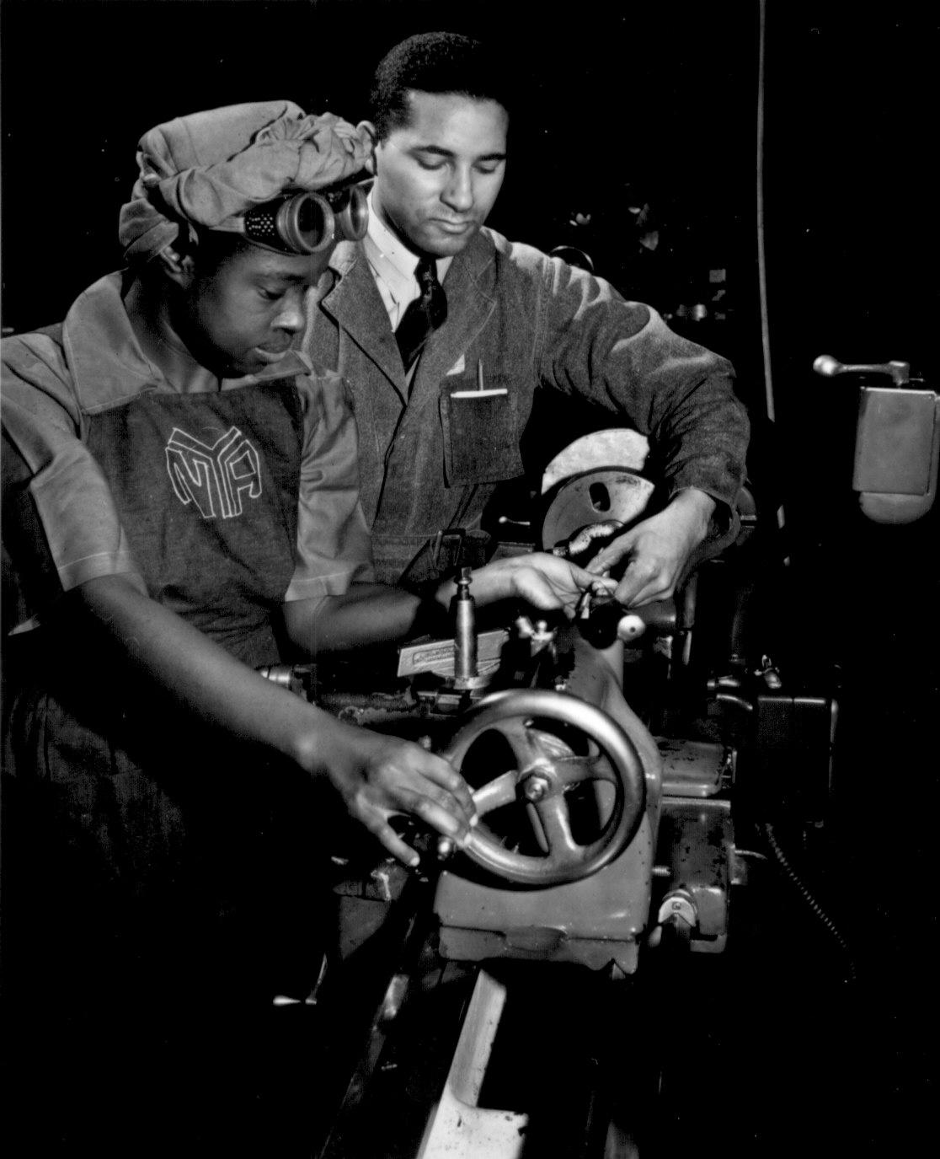
Notes:
"Under the direction of Cecil M. Coles, NYA foreman, Miss Juanita E. Gray learns to operate a lathe machine at the Washington, DC, NYA War Production and Training Center. This former domestic worker is one of hundreds of Negro women trained at this center." N.d. Roger Smith. 208-NP-2QQQQ-1.

Slide 7
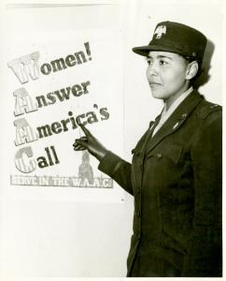
Notes:
Charity Adams, First Officer in the Women's Army Auxiliary Corps (WAAC), Digital ID 1260343, NYPL

Slide 8
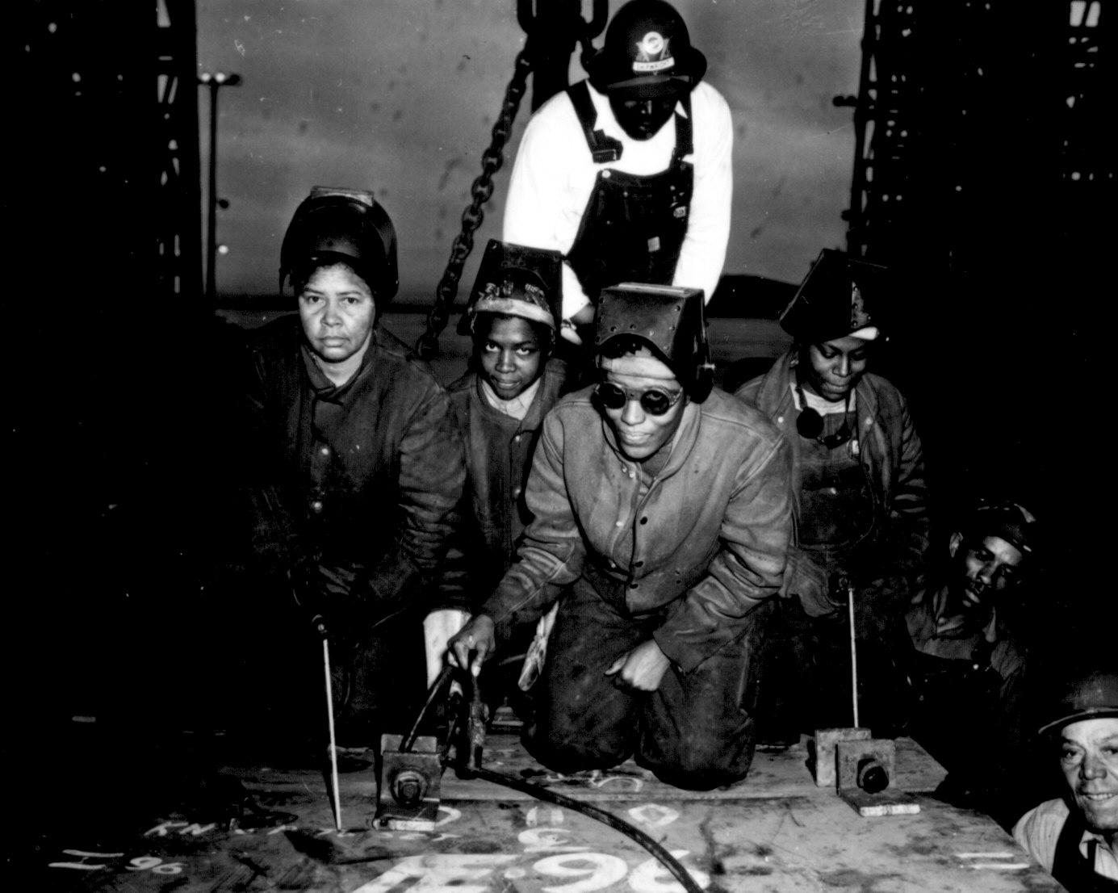
Notes:
"... Welders Alivia Scott, Hattie Carpenter, and Flossie Burtos await an opportunity to weld their first piece of steel on the ship [SS George Washington Carver]." Kaiser Shipyards, Richmond, CA. Ca. 1943. E.F. Joseph. 208-NP-1HHH-5.

Slide 9
Video: African-Americans in WWII
http://www.tubechop.com/watch/1807350

